Slide 1
Design of College Webpage
Mini Modelling Project
Name | Class/Roll No
Sachin Mane | A-28
Naveen Menon | A-29
Arbaz Naikude | A-30
Divyank Nigade | A-31
Aayuka Nirawde | A-32

Slide 2
G.H.Raisoni College Of Engineering & Management Wagholi,Pune
(An Autonomous Institute Affiliated to Savitribai Phule University)
Department of F.Y.Btech (Sem II 2016-17)
Under the Supervision of
Professor. Kirti Amresh
G.H.R.C.E.M, Wagholi,Pune

Slide 3
ACKNOWLEDGEMENT
The most sincere thanks and gratitude to the Almighty god who has erased the difficulty and cleared the ambiguity for us to fulfil this achievement which is my first year project
First of all. We would like to say that it has been my honour to be students of Prof. Kirti Amresh and also, we would like to thank her to be our mini model project supervisor. We would like to thank her for the guidance, support and encouragement she provided to us throughout the entire duration while we were doing and preparing our project.
We also would like to take a moment to thank our dean sir, Dr R.V.Suryavanshi for the support and guidance he showed towards us throughout the journey whenever we needed him.
Last but not the least, we would like to thank our parents and friends who were there for the constant support and encouragement they showed us throughout our project

Slide 4
Introduction
A website is a collection of Web pages, images, videos and other digital assets that is hosted on one or several Web server, usually accessible via the Internet, cell phone or a LAN.
The pages of websites can usually be accessed from a common root URL called the homepage, and usually reside on the same physical server. The URLs of the pages organize them into a hierarchy, although the hyperlinks between them control how the reader perceives the overall structure and how the traffic flows between the different parts of the sites.
A website requires attractive design and proper arrangement of links and images, which enables a browser to easily interpret and access the properties of the site. Hence it provides the browser with adequate information and functionality about the organization, community, network etc.

Slide 5
ABOUT THE PROJECT
The website has been developed for our college (G.H.R.C.E.M) in an effort to make it as attractive and dynamic as possible. Compared to the existing site a database has been added to our project.
The working of the project is as follows.
The first page provides several links. The Home page contains several information about the site like campus, management, facilities, infrastructure etc.
User Login module helps the user to login to the site. For that he must type the username and password correctly. The login provision in this page helps the already registered user to directly access the site and there is a link for registration to a user who is new to this site.
Member Registration module helps the new user to register into the site. The information entered by the users is added into the table registration.
The flash news and the events corner display the latest developments, announcements and events associated with the college activities.
The administrator has the responsibility for displaying the recruiters form on the notice board, in response to which student can submit his willingness to attend the drive along with his resume.

Slide 6
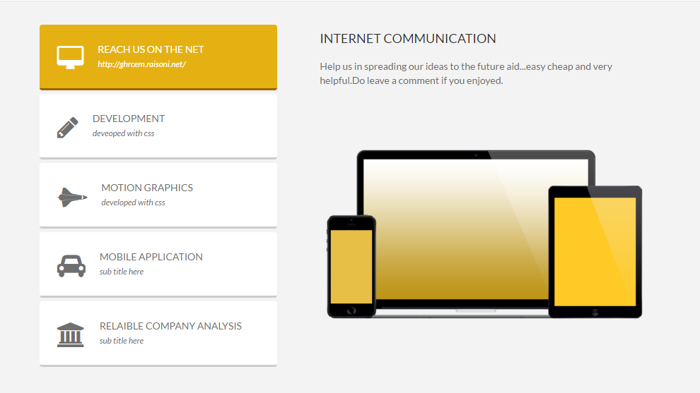

Outlook of our Website

Slide 7
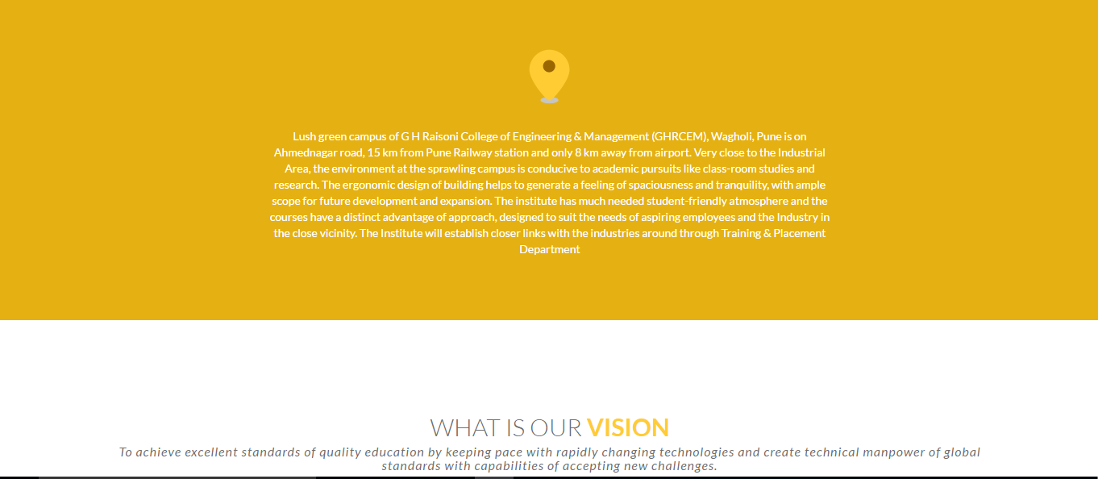
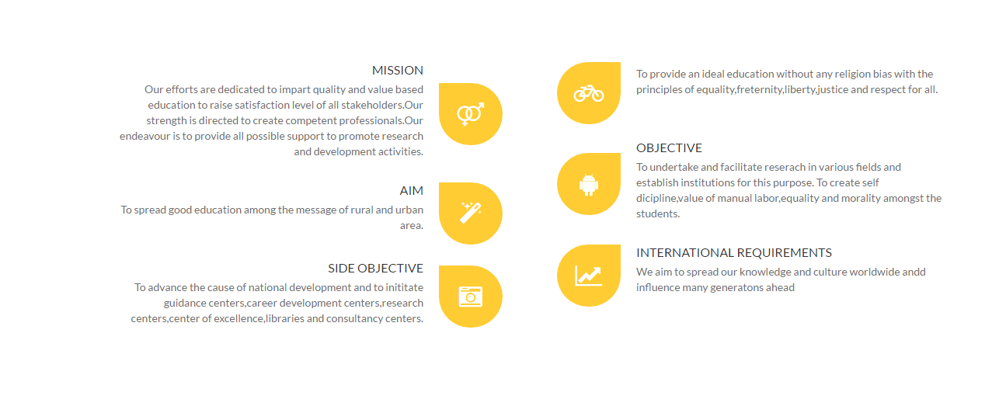

Slide 8
The Conclusion
The project report entitled "COLLEGE WEBSITE CREATION" has come to its final stage. The system has been developed with much care that it is free of errors and at the same time it is efficient and less time consuming. The important thing is that the system is robust. We have tried our level best to make the site as dynamic as possible. Also provision is provided for future developments in the system. The entire system is secured. This online system will be approved and implemented soon
The developed system is flexible and changes can be made easily. The system is developed with an insight into the necessary modification that may be required in the future. Hence the system can be maintained successfully without much rework.
One of the main future enhancements of our system is to include student record that facilitates quick and easy retrieval of student details. Scope has aloes be made to add a link to the library

Slide 9
References
Blanck, Peter. eQuality: The Struggle for Web Accessibility by Persons with Cognitive Disabilities, Cambridge Disability Law and Policy Series, 2015.
Burgstahle, Sheryl. Universal Design in Higher Education: From Principles to Practice, Harvard Education Press, 2008.
Byrne, Jim. 60 hot to touch Accessible Web Design tips – the tips no web developer can live without!, Jim Byrne, 2006, (ISBN: 978-1-4116-6729-7).
Chisholm, and May. Universal Design for Web Applications: Web Applications That Reach Everyone, O'Reilly Media, 2008.
Clark, Joe. Building Accessible Websites, New Riders Publishing, 2002.
Coombs, Norman. Making Online Teaching Accessible, Jossey-Bass, 2010. "Making Online Teaching Accessible" is downloadable from Bookshare.
Cunningham, Katie. The Accessibility Handbook, O'Reilly Media, 2012.
Duckett, Jon. Accessible XHTML and CSS Web Sites Problem Design Solution, Wrox, 2005.
Hassell, Jonathan. Including your missing 20% by embedding web and mobile accessibility, BSI British Standards Institution, 2014.
Henry, Shawn Lawton. Just Ask: Integrating Accessibility Throughout Design, ET\Lawton, 2007.
Horton, Sarah and Quesenbery, Whitney. Universal Design for Web Accessibility, Rosenfeld Media, 2014.
Horton, Sarah and Quesenbery, Whitney. A Web for Everyone, Rosenfeld Media, 2012.

Slide 10
THANK YOU

